Slide 1
Linux Booting Procedure

Slide 2
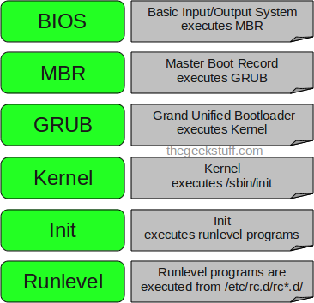


Slide 3
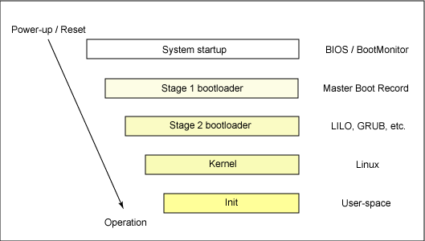
How Linux boot?

Slide 4
How computer startup?
Booting is a bootstrapping process that starts operating systems when the user turns on a computer system
A boot sequence is the set of operations the computer performs when it is switched on that load an operating system

Slide 5
Booting sequence
Turn on
CPU jump to address of BIOS
BIOS runs POST (Power-On Self Test)
Find bootable devices
Loads and execute boot sector form MBR
Load OS

Slide 6
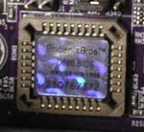
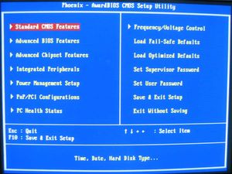
BIOS (Basic Input/Output System)
BIOS refers to the software code run by a computer when first powered on
The primary function of BIOS is code program embedded on a chip that recognises and controls various devices that make up the computer.
BIOS on board
BIOS on screen

Slide 7
MBR (Master Boot Record)
OS is booted from a hard disk, where the Master Boot Record (MBR) contains the primary boot loader
The MBR is a 512-byte sector, located in the first sector on the disk (sector 1 of cylinder 0, head 0)
After the MBR is loaded into RAM, the BIOS yields control to it.

Slide 8
Boot loader
Boot loader could be more adaptly called the kernel loader. The task at this stage is to load the Linux kernel
GRUB and LILO are the most popular Linux boot loader.

Slide 9
Other boot loader (Several OS)
GRUB
LILO
GRUB2WIN
BOOTCAMP
BOOTKEY
NTLDR
Syslinux

Slide 10
GRUB: GRand Unified Bootloader
GRUB is an operating system independant boot loader
A multiboot software packet from GNU
Flexible command line interface
File system access
Support multiple executable format
Support diskless system
Download OS from network

Slide 11
LILO: LInux LOader
Does Not depend on a specific file system
Can boot from harddisk and floppy
Up to 16 different images
Must change LILO when kernel image file or config file is changed

Slide 12
Kernel

Slide 13
Task of kernel
Process management
Memory management
Device management
System call

Slide 14
Init process
The first thing the kernel does is to execute init program
Init is the root/parent of all processes executing on Linux
The first processes that init starts is a script /etc/rc.d/rc.sysinit
Based on the appropriate run-level, scripts are executed to start various processes to run the system and make it functional

Slide 15
The Linux Init Processes
The init process is identified by process id "1“
Init is responsible for starting system processes as defined in the /etc/inittab file
Upon shutdown, init controls the sequence and processes for shutdown

Slide 16
Runlevels
A runlevel is a software configuration of the system which allows only a selected group of processes to exist
Init can be in one of seven runlevels: 0-6

Slide 17
Runlevels
Runlevel | Scripts Directory (Red Hat/Fedora Core) | State
0 | /etc/rc.d/rc0.d/ | shutdown/halt system
1 | /etc/rc.d/rc1.d/ | Single user mode
2 | /etc/rc.d/rc2.d/ | Multiuser with no network services exported
3 | /etc/rc.d/rc3.d/ | Default text/console only start. Full multiuser
4 | /etc/rc.d/rc4.d/ | Reserved for local use. Also X-windows (Slackware/BSD)
5 | /etc/rc.d/rc5.d/ | XDM X-windows GUI mode (Redhat/System V)
6 | /etc/rc.d/rc6.d/ | Reboot
s or S |  | Single user/Maintenance mode (Slackware)
M |  | Multiuser mode (Slackware)

Slide 18
Linux files structure

Slide 19
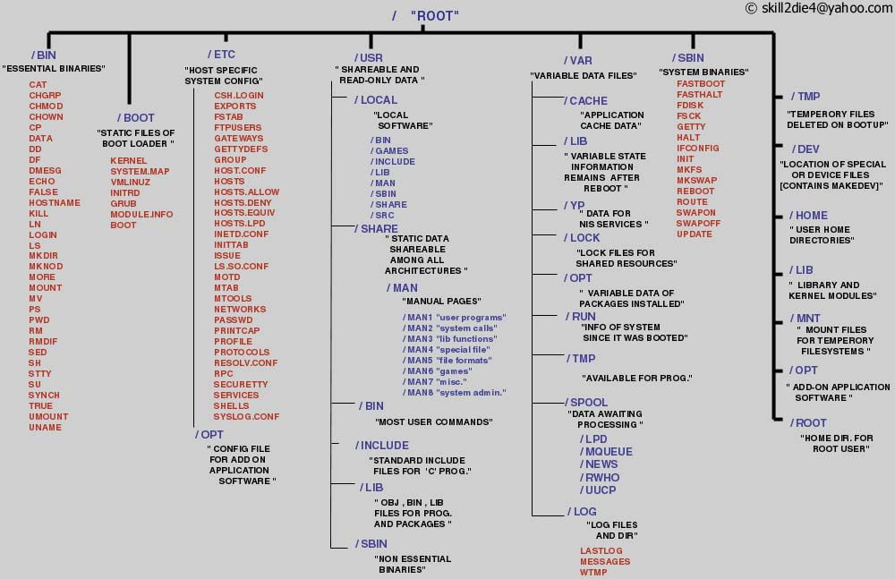
Linux files structure
http://www.secguru.com/files/linux_file_structure

